Slide 1
Example project

Slide 2
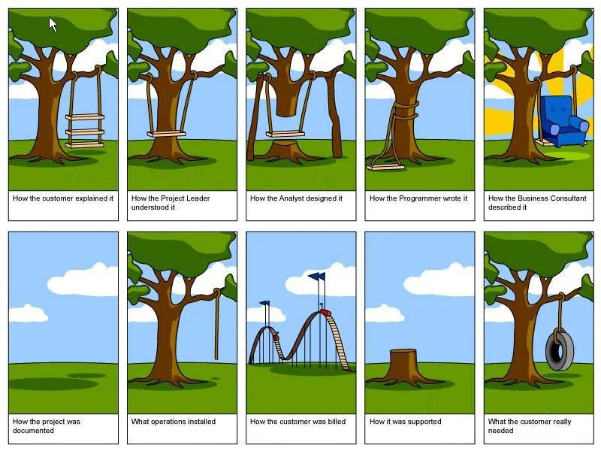
Not in a galaxy far far away…

Slide 3
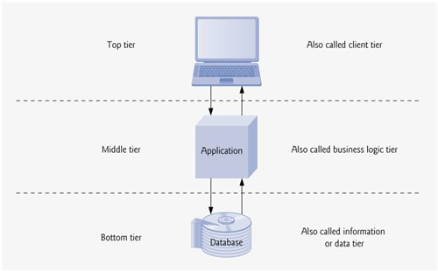
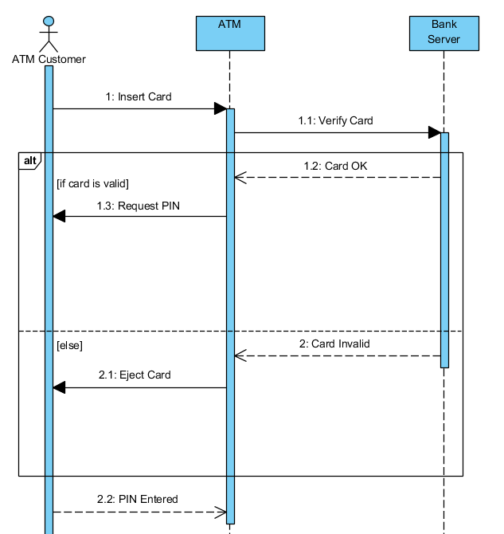
System architecture
Standard n-tier architecture
Presentation
API (REST)
BL
DAL (ORM, code first, migrations, …)
Control/data flows

Slide 4
Creating a new project in gitlab
Create a new project
Optionally add members
Clone to local machine

Slide 5
Setting up the project in the IDE
Create an issue in gitlab + open branch
Open a new project in the IDE
Should start from cloned project folder
Checkout FB
Setup .gitignore
Commit + push to git
In gitlab - open merge-request via the FB, approve it and merge
Update local environment
Checkout master + pull
Delete local FB

Slide 6
Project skeleton - DB
Create an issue in gitlab
Define technical requirements
Open branch
Checkout FB locally
Define build/db folder
Create an SQL script for DB + table creation
Test it using SQL client
Remove table. Django ORM / code first (Django models)
Commit + push + merge process + locally update

Slide 7
Project skeleton - client
Create an issue in gitlab
Define technical requirements
Open branch
Checkout FB locally
Install npx - npm install -g npx
In client parent folder CRA - npx create-react-app a-meaningful-name
Make sure it runs - cd to folder and npm start
Add run configuration
Cleanup client folder: .git, node_modules
Commit + push + merge process + locally update

Slide 8
Project skeleton - server
https://docs.djangoproject.com/en/3.2/intro/tutorial01/
Create an issue in gitlab
Define technical requirements
Open branch
Checkout FB locally
Setup python virtual environment
Import (via intelli) django/djangorestframework/mysqlclient
Activate virtualenv and create project under server folder
Make sure it runs - cd to folder and ..\..\..\venv\Scripts\python.exe .\manage.py runserver
Add run configuration
Commit + push + merge process + locally update

Slide 9
Adding a new feature - server
Update django settings to support MySQL server newly installed_app
Django model
Create model/make-migrations/migrate/check sql client to see the table
Activate venv
python.exe .\manage.py makemigrations sapir_server_example
python.exe .\manage.py migrate
Verify with MySQL client
view/serializer
Url
Test it (http://127.0.0.1:8000/colors/generate-new-color)

Slide 10
Adding a new feature - client
Add API call
Add axios
Add api.js
Update proxy
Run client
Update a view
Test it
See new records in DB

Slide 11
Taks 1
https://docs.google.com/spreadsheets/d/1gmkZQKcTfgP0FBm17b9JhDxBzT_UL_r1YE7c6sxnr9Y/edit?usp=sharing

